Slide 1
MINECRAFT WIKI 2.0!
ADAM AND ARJUN

Slide 2
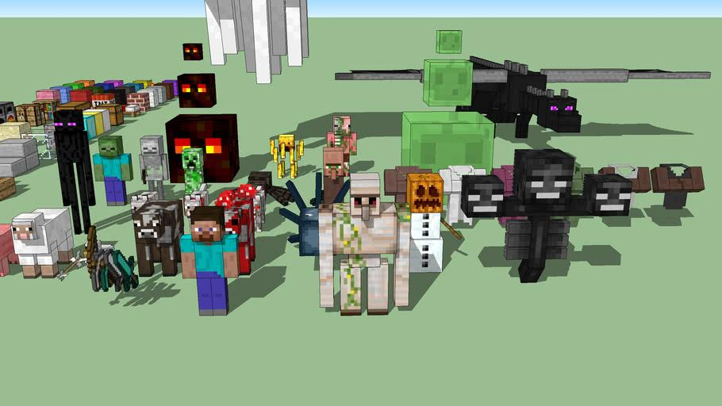
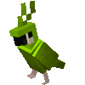
MINECRAFT MOBS

Slide 3
PASSIVE MOBS

Slide 4
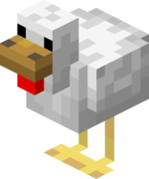

Chicken
Has 4 hp
Height: 0.35 Blocks
Width: 0.2 Blocks
Passive
Spawn
Solid surfaced blocks with a minimum of two block spaces above them
A ¹⁄₈ chance from a thrown egg
Breeding
Will follow if you have seeds in hand
Can be bred with any kind of seed
Lays eggs every 5-10 min
Drops
One raw chicken and maybe a feather

Slide 5
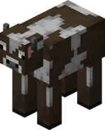
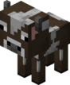
Cow
10 hp
Height 1.4 blocks
Width 0.9 blocks
Passive
Spawn
Grass blocks with at least two blocks of space above them.
After shearing a mooshroom
Drops
0-2 leather, which can be used to craft leather armor
0-2 raw beef
Breeding
Will follow a player with wheat in hand
Can be bred with wheat
Special Qualities
Can be milked with a bucket
Milk removes all potion effects from the drinker

Slide 6
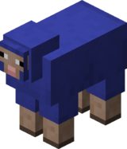
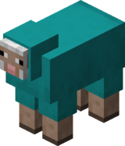
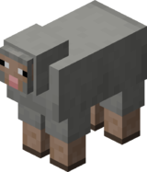
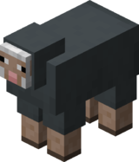
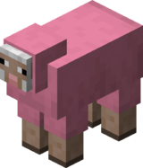
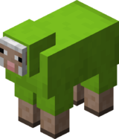
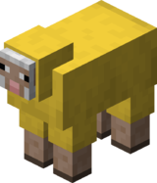
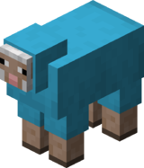
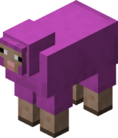
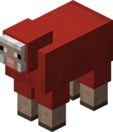
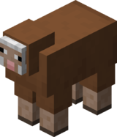
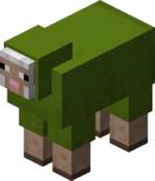
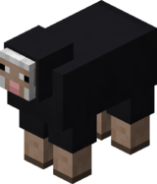
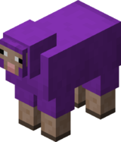
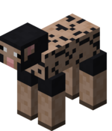

SHEEP
8 hp
Drops wool(1) and mutton(1-3)
Useful in beginner game survival because with three wool, a bed is craftable.
Height: 1.25 blocks
Width: 1.4375
Any color, white being the most common.
You can dye a sheep’s wool into the color of the dye, then, if sheared, will drop it’s respected color
If you need a rainbow sheep, you can name tag it exactly this: jeb_
Follows player that holds wheat.
If too sheep are fed bread on love mode, they will breed and make a baby sheep.

Slide 7
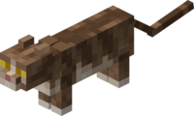
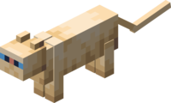
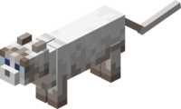
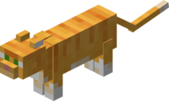

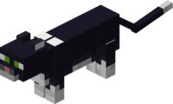
Cats
Found in villages
Tamable with either cod or salmon.
10 hp
Black cat always found around or in a swamp hut.
Creepers and Phantoms are scared of cat.
When tamed, the cat sleeps with the player and drops loot. Here is a table of what loot you can get:
There are different type of cats:

Slide 8
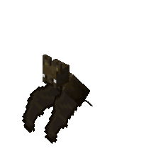
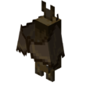
Bats
6 hp
Height:0.9 Blocks
Width: 0.5 Blocks
Spawn
light level of 6 or less in neighboring blocks
Drops
None
Special Properties
Can hang upside down from one block spaces

Slide 9
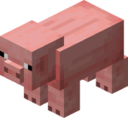
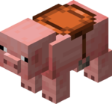
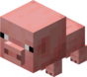
Pigs
10 hp
Height: 0.9 Blocks
Width: 0.9 Blocks
Spawning
Grass with at least two block space above
Breeding
Can be bred with a carrot or a golden carrot
Will follow a player holding a carrot or golden carrot
Special Properties
Can be ridden on with a saddle and it will act like a horse if the riding player has a carrot on a stick in hand
Once you saddle a pig, the only way to get the saddle back it by killing it

Slide 10







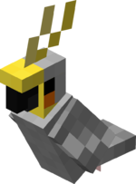


Parrots
Have 5 different designs.
When fed seeds, parrots will tame with no collar.
When tamed, make it stand up, and try to push it to make it go on your shoulder.
Found in any type of jungle.
When about to drown, can fly out of the water.
The challenge about taming one it how to get it down, they even fly on top of mega trees!!
Unfortunately, you can’t breed parrots and also no such thing as a parrot baby or egg.
6hp
And best of all, parrots dance to jukeboxes when tamed!!!

Slide 11
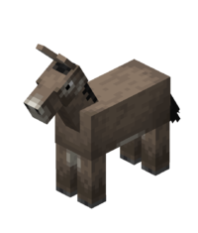
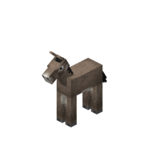
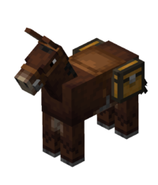
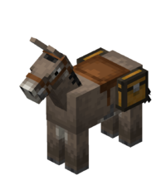
Mules and Donkeys
Doesn’t have an exact hp value
Can be saddled, and can have an attached chest
Mules can’t be breed while donkeys can
Mules are spawned through the breeding of a tamed donkey and a horse

Slide 12
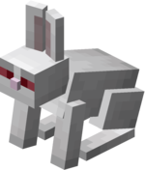
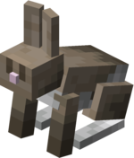
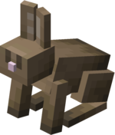
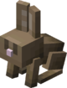
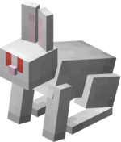
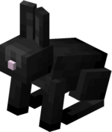
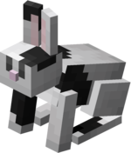
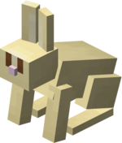
Rabbits
3 hp
Height: 0.5 Blocks
Width: 0.4 Blocks
Spawning
Grass block, snow, or sand
Breeding
Can be bred with carrot or golden carrot
Will follow players holding a carrot, golden carrot, or a dandelion
Special Properties
Has a form called the Killer Bunny(See hostile mobs)
If named Toast with a name tag, it will retexture into a white bunny with black spots

Slide 13
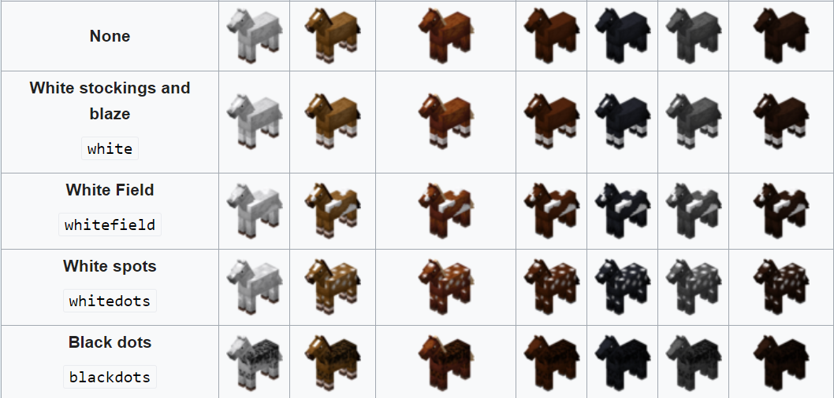
Horse
15-30 hp
Height 1.6 blocks
Width 1.4 blocks
Spawning
Plains, Savanna, and villages
Breeding
Can be bred with hay bale, apple, golden carrot, and wheat
Will follow a player carrying a hay bale, apple, golden carrot,sugar, or wheat
Special Properties
Can wear horse armor
Can be tamed by a player and ridden with a saddle

Slide 14
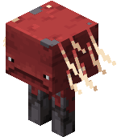
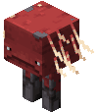
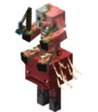
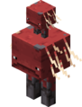
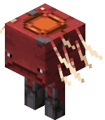
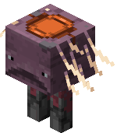

Strider
Striders an be saddled and ridden with Warped fungi on a stick.
When in lava, the player nor the strider will take damage. Also, if in lava, will stop shivering and will turn red and warm
When out of lava, turns purple and starts shaking
There is no way to get the saddle from a strider back unless you kill it
Sometimes, you i'll find zombified piglins of striders called strider jockey
Also, baby striders often ride on their mom’s back
20 hp on Java
15 hp on bedrock

Slide 15



Squid and Glow Squid
In Bedrock Edition:
Adult:
Height: 0.95 blocks
Width: 0.95 blocks
Baby:
Height: 0.475 blocks
Width: 0.475 blocks
UP COMING IN 1.17 Caves and Cliffs

Slide 16



Mooshroom
Adult:
Height: 1.3 Blocks
Width: 0.9 Blocks
Baby:
Height: 0.65 Blocks
Width: 0.45 Blocks

Slide 17


Axolotl
14 hp
Height:0.6
Width:1.3
Spawning
Spawns in underground bodies of water
Special Properties
Can be put in a bucket or on a leash
Attack strength 2, attacks drowned, elder guardian, and guardian when tamed
May “play dead” when at low hp
When swimming near a player gives speed and regen
Dies after 5 minutes on land
UP COMING IN 1.17 Caves and Cliffs

Slide 18
Neutral Mobs

Slide 19






Wolf
8 hp
Height: 0.85 Blocks
Width: 0.6 Blocks
Spawning
Spawns in forests, snowy taiga, and taiga biomes
Special Properties
Can be tamed with bones to become a dog
If hit, or encounters a sheep or fox, it becomes angry and hits the thing it is angry at
Tamed wolves collar color can be changed with dye
Breeding
Tamed wolves can be bred with meat
Untamed wolves cannot enter breed

Slide 20



Llama
15-30 hp
Height: 1.87 Blocks
Width: 0.9 Blocks
Spawning
Mountains and savanna, and leashed by the wandering Trader
Breeding
Can be bred with hay bales
Will follow a player carrying hay bales or wheat
Special Properties
Can be ridden on with a carpet but without control
A player can put a chest on it with or without items in it
A llama with a chest cannot despawn

Slide 21



Enderman
40 hp
Normal:
Height: 2.9 Blocks
Width: 0.6 Blocks
Angry:
Height: 3.25 Blocks
Width: 0.6 Blocks
Spawning
Overworld: Light level of 7 or less.
Nether:
Nether Wastes
Warped Forest
Soul Sand Valley
End: Light Level of 11 or less
Special Properties
Will become hostile if you look it in the eye, unless you are wearing a pumpkin head
Can teleport
Does 8 damage per hit

Slide 22


Zombified piglin
Look like a cross between a zombie and a piglin
Only fights when is hit, and the whole group will attack.
Sometimes spawn on striders with a warped fungi on a stick and a saddle.

Slide 23

Spider
Behavior
Neutral (light >11)
Hostile (light ≤11)
Attack strength
Easy: 2
Normal: 2
Hard: 3

Slide 24




Iron Golem
100 hp
Hostile when hit or when you hit a villager in it’s village.
Automatically attacks zombies, skeletons, magma cubes, spiders, zombie villagers, and more!
The more you hit an Iron Golem, the more cracks will show on it (Java only)
Can be made by placing 4 iron blocks on a cross and a jack-o-lantern at the top
Summoned Iron Golems will remain passive to the player

Slide 25


Piglin
16 hp
Neutral only to players wearing a piece of golden armor, or else, will become hostile
Can be bartered with with gold ingots.
When in the overworld, will start shaking and will turn into a zombified piglin.
Any nearby storage spaces opened will tiger piglets

Slide 26


Goat
Health:
10xp
Height: 0.9 Blocks
Width: 0.65
Spawn: Mountains and Snowy Slopes
UP COMING IN 1.17 Caves and Cliffs

Slide 27


Polar Bear
Health:
30xp
Height: 1.4 Blocks
Width: 1.3
Spawn: Snowy Tundra, Ice Spikes, Iceburg

Slide 28
Hostile Mobs

Slide 29



Skeleton and strays
20 hp
Height: 1.99 Blocks
Width: 0.6 Blocks
Spawning
Overworld: Light level of 7 or less.
Nether:
Nether Fortress
Soul Sand Valley
Drops
0-2 bones
0-2 arrows
Has chance of dropping gear
Special Properties
Does 1-3 dmg
Shoots with a bow
Can spawn with gear
It’s brother is the stray
If a stray hits you you get the slowness effect

Slide 30











Baby Zombie
Same hp and damage as a zombie
2 times the speed of a zombie
Special Properties
Can ride:
Cows
Ocelots and Untamed cats
Untamed wolves
Mooshrooms
Adult chickens
Adult foxes
Baby Boglins
Pigs
Pandas
Sheep
Horses
Donkeys
Mules
Zombie Horses(Unused jockey variant)
Skeleton Horses
Adult Zombies
Adult Zombie Villagers
Adult Husk
Adult drowned
Adult zombified piglins (unused)
Spiders
Cave Spiders

Slide 31






Zombie and their Variants
40 hp
Variants are Zombie, Husk, and Drowned
Zombie spawns in any biome
Husk spawn in desert.
And Drowns spawn in water.
If a zombie variant drowns, it becomes a drowned
Drowned cannot drown
Drowned can swim and spawn with tridents
Husks do not burn in daylight

Slide 32





THE ILLAGERS
illagers are what I call a nation. They work together with Allies such as the witch and ravagers, they have outposts and homes, they raid villages. they even have a flag! They are a strong, strong nation.
The illagers consist of evokers, pillagers, Vindicators
Raid captains have the illager flag:

Slide 33


Hoglin
40 hp
JE:
Height: 1.4 Blocks
Width: 1.3965 Blocks
BE:
Adult:
Height: 0.9 Blocks
Width: 0.9 Blocks
Baby:
Height: 0.45 Blocks
Width: 0.45 Blocks
Spawning
Crimson Forest
Bastion
Breeding
Can be bred with crimson fungus
Special Properties
3-8 dmg
Hoglins become passive while near warped fungi, nether portals, and respawn anchors
If a Hoglin goes through a Nether Portal, It becomes a Zoglin
Are hunted by Piglins and Piglin Brutes
Only source of food in Nether

Slide 34

Zoglin
Exactly like the hoglin
Attacks anything
When A hoglin goes to the overworld, they turn into a zoglin

Slide 35


Creeper
20 hp
Height:1.7 blocks
Width:0.6 blocks
Spawning
Light level of seven or less
Special Properties
If you get too close to it, it will explode
If struck by lightning, it becomes a charged creeper
Explosion damage:43 hp (Max)
Charged Creeper Explosion Damage:84 hp (Max)
1 random music disc (excluding Pigstep), if killed by a skeleton or stray
If killed by a charged creeper, drops a creeper head

Slide 36


Witch
26 hp
Height: 1.9
Width: 0.6
Spawning
As part of raids
In witch huts
In light level 7 or less
When a lightning bolt strikes within 7 blocks of a villager
Special properties
They have a chance of dropping many potion related items
If killed while drinking a potion(Healing, Fire Resistance, Swiftness, Water Breathing), has an 8.5 percent of dropping the potion
Can throw potions of fatal poison and potions of harming and used to be able to throw potions of slowness

Slide 37



Ravanger
Height: 1.9 Blocks
Width: 1.5 Blocks
Spawn: Raids Wave 3
Health Damage:
E: 7
N: 12
H: 18
Speed: 0.3

Slide 38
Boss Monsters

Slide 39



Wither
300 hp
4 armor points
Height: 3.5 blocks
Width: 0.9 blocks
Damage
Wither skull: 8 dmg and wither II for 10 secs
Dash attack: 15 dmg
Spawning
Built by player 10 second spawn delay
Special Features
When it is at half health, it will become invulnerable to projectiles and change color
If it kills a mob, the mob will drop a wither rose
Spawned by building a T with 4 soul sand or soil and placing 3 wither skulls on the top of the formation

Slide 40

Ender Dragon
200 hp
THE ULTIMATE BOSS!
You beat it, you beat Minecraft
Spawns: In the end
Don’t run on its breath!

Slide 41

MINECRAFT ORES

Slide 42




Coal
Use: Smelting, Torches, Coal Blocks
Coal Ore
Deepslate Coal Ore (1.17)

Slide 43





Iron
Use: Hopper, Pistons, Iron Blocks, Armor, Tools, Doors, powering beacons...

Slide 44




Copper
Use: Can be used to craft stairs and slabs with ingots and rusts, creating a beautiful green block

Slide 45






Redstone
Use: Can be used to make and craft a variety of machines

Slide 46




Lapis Lazuli
Use: Enchanting, Blocks

Slide 47




Diamond
Use: Tools, Enchanting Table, Juke Box, Diamond Block, Tools, Armor, powering beacons

Slide 48




Netherite
Use: Block, Armor, Tools, Beacon

Slide 49




Emerald
Use: Villager trading and powers beacons

Slide 50

MINECRAFT BIOMES

Slide 51
Land Biomes

Slide 52

Plains
Description: Flat, made of light green grass blocks and oak trees
Exclusives: N/A

Slide 53

Extreme Hills/Mountains
Description: Lots of hills, dark green grass
Exclusives:Goats, deep snow, powder snow

Slide 54

Savanna
Description: Flat, or in some areas VERY high mountains grass is yellowy green.
Exclusives: Acacia trees

Slide 55

Mesa
Description: Has numerous plateaus.
Exclusives: Terracotta, increased rate of gold and abandoned mineshafts.

Slide 56

Desert
Description: Flat, full of sand and cacti
Exclusives: Sand, cacti, desert temples

Slide 57

Jungle
Description: A dense tropical forest with towering jungle wood tree
Exclusives: Jungle temples, Jungle wood, cocoa beans, bamboo, Panda, Parrots

Slide 58

Taiga
Description: Full of hills, wolves, dark green grass, sweet berries, ferns, villages, orange foxes
Exclusives: Spruce Wood, Sweet Berries

Slide 59

Snowy Taiga
Description: Full of hills, wolves, dark green grass, sweet berries, ferns, villages, snow, white foxes
Exclusives: Spruce Wood, Sweet Berries

Slide 60

Snowy Tundra
Description: a relatively flat terrain full of snow with a few spruce trees
Exclusives: Igloos

Slide 61

Flower Forest
Description: A beautiful forest with trees spaced far enough apart to comfortably walk through
Exclusives: Lily of the Valley

Slide 62

Forest
Description: A beautiful forest with trees spaced far enough apart to comfortably walk through
Exclusives: None

Slide 63

Ice Spikes
Description: An inhospitable hilly terrain covered with snow and giant spikes of ice
Exclusives: Ice spikes

Slide 64

Mushroom Fields
Description: An extremely rare biome with a special substance called mycelium. It spreads like grass on dirt and mobs cannot spawn on it the biome also has giant mushrooms.It is never very large.
Exclusives: Mycelium, mooshroom

Slide 65
Ocean Biomes

Slide 66

Frozen Ocean
Description: An inhospitable hilly terrain covered with snow and giant ice
Exclusives: None

Slide 67

Warm Shallow Ocean
Description: Light blue, see through
Exclusives: coral reef, tropical fish, pufferfish

Slide 68
Warm Deep Ocean
Description: Light blue, see through
Exclusives: coral reef, tropical fish, pufferfish, Ocean Monuments

Slide 69
Cold Shallow Ocean
Description: Dark blue, gravel bottom
Exclusives: Kelp

Slide 70
Cold Deep Ocean
Description: Dark blue, gravel bottom
Exclusives: Kelp, ocean monuments

Slide 71

Lukewarm Shallow Ocean
Description: Light blue, see through
Exclusives: Kelp

Slide 72
Lukewarm Shallow Ocean
Description: Light blue, see through
Exclusives: Kelp

Slide 73
Lukewarm Ocean
Description: An inhospitable hilly terrain covered with snow and giant ice
Exclusives: None

Slide 74
Cold Ocean
Description: An inhospitable hilly terrain covered with snow and giant ice
Exclusives: None

Slide 75

MINECRAFT FOODS

Slide 76
CREDITS

Slide 77


Beef
From: Cows
Nourishmentt: Cooked: 8 points
Raw: 3 points

Slide 78
Mutton
From: Cows
Nourishmentt: Cooked: 8 points
Raw: 3 points

Slide 79



Adam Kasouit
Discord: Sniper-Shark#3624
Hangouts: akasouit@gmail.com
Minecraft: SharkKnight4

Slide 80

Arjun Sargur
Discord: The_Legend_27#3901
Hangouts: arjunsargur@gmail.com
Minecraft: ObsessedCoder13

